Slide 1
FULL STACK TRAINING

Slide 2
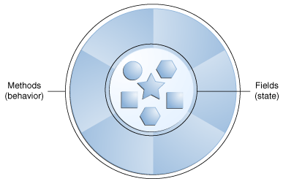
Java Class Loading
Java Class
A Java class file is a file (with the .class filename extension) containing Java bytecode that can be executed on the Java Virtual Machine (JVM). A Java class file is usually produced by a Java compiler from Java programming language source files (.java files) containing Java classes (alternatively, other JVM languages can also be used to create class files)
Java Object

Slide 3
Java Class Loading
What happens when this line is executed in Java?
Car myCar;
myCar = new Car();

Slide 4
Java Class Loading
What happens when this line is executed in Java?
Car myCar;
myCar = new Car();
Line 1 creates a reference of type ‘Car’ in the Stack

Slide 5
Java Class Loading
What happens when this line is executed in Java?
Car myCar;
myCar = new Car();
Line 1 creates a reference of type ‘Car’ in the Stack
Lot of action happens in Line 2
The ‘Car’ class is loaded into the main memory.
Memory is allocated for the members of ‘Car’ class in heap space.
Fields are initialized to their default values. (Q: What happens to Static fields? When are they initialized)
Chosen constructor is invoked

Slide 6
Java Class Loading
Car myCar;
myCar = new Car();
Class myCarClass = myCar.getClass();
Now what is myCarClass?

Slide 7
Java Class Loading
Car myCar;
myCar = new Car();
Class myCarClass = myCar.getClass();
Now what is myCarClass?
What we get is a Runtime class of the ‘Car’ myCar object.
What that means is that we can an Object of type ‘Class’ which represents the class of the Object ‘myCar’ which is ‘Car’

Slide 8
Example

Slide 9
Agile Manifesto
Published in 2001
The four core values of agile software development as stated by the Agile Manifesto emphasize:
Individuals and interactions over processes and tools.
Working software over comprehensive documentation.
Customer collaboration over contract negotiation.
Responding to change over following a plan.

Slide 10
12 Principles of Agile Manifesto
Principle | Description
Satisfaction and Delivery | Customer satisfaction through early and continuous working software.
Welcoming Change | Welcome changing requirements, even at later stages of development.
Deliver Frequently | Deliver working software frequently (weekly rather than monthly).
Communication is the Key | Ensure close association of developers with business people on daily basis.
Environment and Trust | Build projects around motivated individuals. Give them necessary support and trust them.
Face-to-face Communication | Encourage face-to-face conversation to ensure efficient and effective communication.
Software as Measure of Progress | Working software is the primary measure of progress.
Sustainable Development | Promote sustainable development with the ability to maintain a constant pace throughout the development.
Attention to Details | Continuous attention to technical excellence and good design.
The Power of Less | Simplicity is essential.
Self-organizing Teams | Regular attention of the team on becoming effective in changing circumstances.

Slide 11
Agile Characteristics
Iterative/incremental and Ready to Evolve
break a problem into smaller tasks.
There is no direct long-term planning for any requirement.
iterations are planned which are of vary short period of time.
A cross-functional team is created for each iteration.
Face-to-face Communication
Each agile team should have a customer representative such as a product owner.
This representative is authorized to act on behalf of the stakeholders and he can answer the queries of the developers in between iterations.
Feedback Loop
Daily stand-up is a common culture of any agile development, called Daily Scrum

Slide 12
Daily Stand Up
A daily stand-up is a daily status meeting among all team members and it is held roughly for 15 minutes.
Every member has to answer three important questions −
What I did yesterday?
What I'll do today?
Any impediment I am facing.../ I am blocked due to...
Daily stand-up is for status update, not for any discussion. For discussion, team members should schedule another meeting at a different time.
Participants usually stand instead of sitting so that the meeting gets over quickly.

Slide 13
Importance of Daily Stand Up
The team can evaluate the progress on a daily basis and see if they can deliver as per the iteration plan.
Each team member informs all about his/ her commitments for the day.
It provides visibility to the team on any delay or obstacles.

Slide 14
Attendees
The scrum master, the product owner, and the delivery team should attend the stand-up on a daily basis.
Stakeholders and Customers are encouraged to attend the meeting and they can act as an observer, but they are not supposed to participate in stand-ups.
It is the scrum master's responsibility to take note of each team member's queries and the problems they are facing.

Slide 15
Multi Geographical Teams
Stand-ups can be done in multiple ways, in case the agile team members are operating from different time zones −
Select a member on a rotational basis, who can attend the stand-up meeting of teams located in different time zones.
Have a separate stand-up per team, update the status of the stand-up in a tool such as Rally, SharePoint, Wikis, etc.
Have a wide variety of communication tools ready like conference call, video conferencing, instant messengers, or any other third-party knowledge sharing tools.

Slide 16
Terminologies
User Story
A user story is a requirement which is formulated in a few sentences in everyday language of an user and it should be completed within an iteration
Iteration/Spring
An iteration is a time boxed collection of user stories / defects to be worked upon and accepted within the release of a product. Iterations are defined during iteration planning meeting and completed with an iteration demo and review meeting. An iteration is also termed as a sprint
Release
A release is a major milestone that represents an internal or external delivery of working, tested version of the product/system

Slide 17
Terminologies
Acceptance Criteria
It is the conditions set by the product owner or the customer in order to accept a feature to be valid and adhering to their requirements.
Feature
An improvement done to a product or capability of value to stakeholder which can be developed in a release.
Product Owner
The product owner is a member of the Agile delivery team, responsible to collect and rank business requirements in the product backlog. A product owner communicates what is to be done in a release/iteration. He/she sets the commitments and is responsible to protect team from any change in requirements during an iteration.
Task
It is a unit of work that contributes towards the completion of a user story within an iteration. User stories are decomposed into multiple tasks and each task can be divided between team members marking them as owner of the tasks. Team members can take responsibility of each task, update estimates, log work done or to-do as desired.

Slide 18
Terminologies
Task
It is a unit of work that contributes towards the completion of a user story within an iteration. User stories are decomposed into multiple tasks and each task can be divided between team members marking them as owner of the tasks. Team members can take responsibility of each task, update estimates, log work done or to-do as desired.
Velocity
A measure to weight the accepted work in an iteration or timebox. Normally it is the sum of story points accepted in an iteration.
Capacity
It is the amount of work a team can take to complete in one iteration.

Slide 19
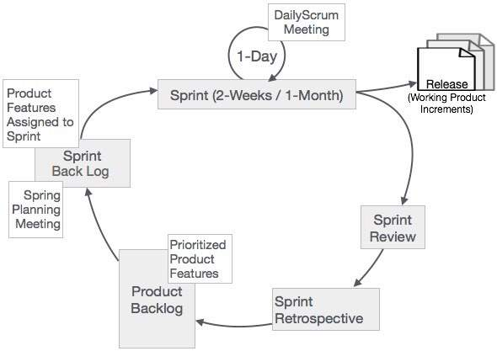
Scrum - Overview
Scrum is a framework within which people can address complex adaptive problems, while productively and creatively delivering products of the highest possible value
Developed by Ken Schwaber and Jeff Sutherland
The Scrum framework consists of Scrum Teams and their associated roles, events, artifacts, and rules

Slide 20
Sprint
Sprint is the heart of Scrum. Time boxed between 1 to 4 weeks where a releasable product increment is created.
Sprint. Sprints consist of the Sprint planning, daily scrums, the development work, the Sprint review, and the Sprint retrospective.
In Sprint planning, the work to be performed in the Sprint is planned collaboratively by the Scrum Team.
The Daily Scrum Meeting is a 15-minute time-boxed event for the Scrum Team to synchronize the activities and create a plan for that day.
A Sprint Review is held at the end of the Sprint to inspect the Increment and make changes to the Product Backlog, if needed.
The Sprint Retrospective occurs after the Sprint Review and prior to the next Sprint Planning. In this meeting, the Scrum Team is to inspect itself and create a plan for improvements to be enacted during the subsequent Sprint.

Slide 21
Roles
Scrum Master
making the process run smoothly
removing obstacles that impact productivity
organizing and facilitating the critical meetings
Product Owner
Expressing Product Backlog items clearly.
Ordering the Product Backlog items to best achieve goals and missions.
Optimizing the value of the work the Team performs.
Ensuring that the Product Backlog is visible, transparent, and clear to all, and shows what the Team will work on further.
Ensuring that the Team understands items in the Product Backlog to the level needed.
Team
self-organizing and cross-functional
comprises of analysts, designers, developers, testers, etc. as appropriate and as relevant to the project

Slide 22
The ScrumMaster
ScrumMaster Services to the Product Owner
Finding techniques for effective Product Backlog management.
Helping the Scrum Team understand the need for clear and concise Product Backlog items.
Understanding product planning in an empirical environment.
Ensuring that the Product Owner knows how to arrange the Product Backlog to maximize value.
Understanding and practicing agility.
Facilitating Scrum events as needed.
ScrumMaster Services to the Scrum Team
Coaching the Scrum Team in self-organization and cross-functionality.
Helping the Scrum Team to create high-value products.
Removing impediments to the Scrum Team’s progress.
Facilitating Scrum events as requested or needed.
Coaching the Scrum Team in organizational environments in which Scrum is not yet fully adopted and understood.

Slide 23
Events
The Sprint
Sprint Planning
Daily Scrum Meetings
The Sprint Review
The Sprint Retrospective

Slide 24
Scrum Artifacts
Product Backlog
Sprint Backlog
Burn-Down Chart
Increment

Slide 25
User Stories
The major benefit of User Story lies in the user centric definition itself. This is because, ultimately, it is the user who will be using the product in the relevant user scenarios. It connects the end users to the team members.
The syntax of the User Story itself ensures to capture the goal or benefit or value that the user wants to achieve.
Since the acceptance criteria forms part of user story itself, it will be an added advantage to the Scrum Team.
It is possible to make changes to a user story in course of the execution of the project. If the scope of the user story becomes large, it needs to be split into smaller user stories. The conditions in the acceptance criterion can also be changed.
As working product increments are delivered to the users at the end of each sprint, the scrum team can get feedback from the users in sprint review meeting. This enables incorporation of feedback into the product continuously.

Slide 26
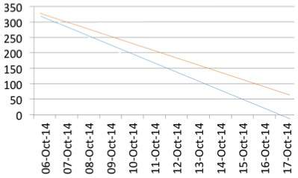
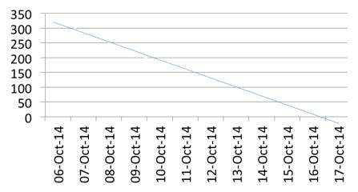
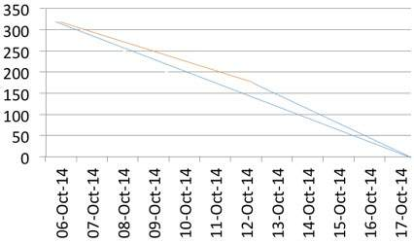
Burn Down Chart
A
C
T
U
A
L
I
D
E
A
L
PLANNED

Slide 27
Estimation
Numeric Sizing (1 through 10)
T-shirt Sizes (XS, S, M, L, XL XXL, XXXL)
Fibonacci Sequence (1, 2, 3, 5, 8, 13, 21, 34, etc.)
Dog Breeds (Chihuahua,………,Great Dane)
Planning Poker Estimation Technique
Expert Opinion based Estimation approach
Analogy Estimation uses comparison of User Stories
Disaggregation Estimation is done by splitting a User Story into smaller, easier-to-estimate User Stories

Slide 28
TASK FOR THE DAY
Create an account on IceScrum (TBD by the Product Owner).
Create a Team
Assign Project/Team Name.
Play around with the demo project
Create 2 User Stories for the upcoming project.
Add team members to the project.

Slide 29
HAVE A NICE DAY

